Slide 1
OpenStack Tutorial
Vasinee Siripoonya
Kasidit Chanchio

Slide 2
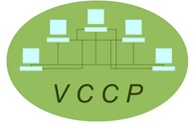
Vasabilab
Conduct Virtualization and Cloud Computing
Promote OpenStack in Thailand
Our Current Projects
(http://vasabilab.cs.tu.ac.th)

Slide 3
Outline
Introduction to Cloud Computing
OpenStack Overview
OpenStack Demo

Slide 4
Cloud Computing
Cloud Computing ‘s characteristics:
Scale with increasing demand
Accessible anytime
Have Cloud operating system to manage resources and hide details from users
Pay Per Uses

Slide 5
1. Scalability
Processing resources for 1

Slide 6
Processing resources for an organization

Slide 7
2. Accessible Anytime
Required
Resources
Time

Slide 8
Required
Resources
Time

Slide 9
3. Cloud Operating Systems
Cloud OS

Slide 10
4. Pay Per Uses
May
Required
Resources
Feb
Jun
Jan
Mar
Apr
Time

Slide 11
May
Required
Resources
Feb
Jun
Jan
Mar
Apr
Time

Slide 12
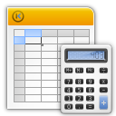
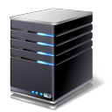
Type of Services: Software
SaaS

Slide 13
Type of Services: Platform
PaaS

Slide 14
Type of Services: Infrastructure
IaaS

Slide 15
Cloud Layers
SaaS
PaaS
IaaS

Slide 16
Service Space
Private Cloud
Use within org
Org pays
Share resources within org
Public Cloud
Use on Internet
Pay per uses
Share resources with everyone
Lower
demands
Higher
demands
Hybrid Cloud

Slide 17
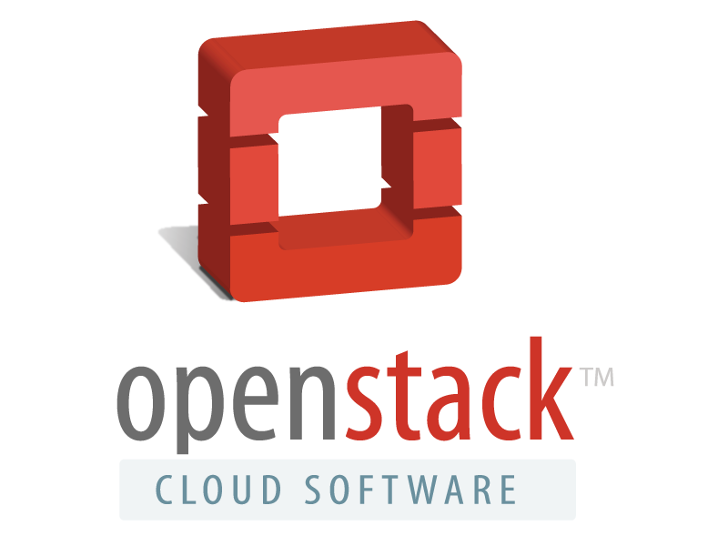

Slide 18
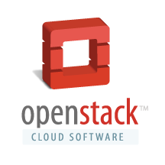
OpenStack Overview
Cloud OS developed by Rackspace and NASA
Infrastructure as a Service
Support Private Cloud and Public Cloud
Open Source (Apache 2.0 license)
OpenStack Foundation
Popular and widely supported

Slide 19
What OpenStack provide?

Slide 20
1. manage virtual machines

Slide 21
2. manage virtual networks

Slide 22
3. manage virtual storages

Slide 23
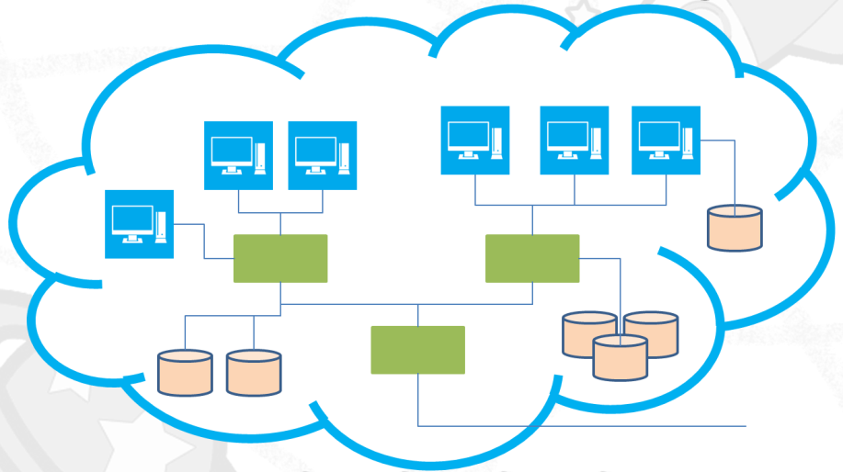
4. Multi-tenents

Slide 24
OpenStack ปฏิบัติการอยู่ใน Layer ไหน
User IT Infrastructure
Cloud OS
Virtualization/OS
Hardware/Storage/Network

Slide 25
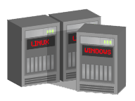
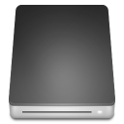
OpenStack Components
DASHBOARD
KEYSTONE

Slide 26
OpenStack Dashboard (Horizon) : Web-based User interface
OpenStack Identity Service (Keystone) : Authentication and authorization

Slide 27
OpenStack Components
NOVA
GLANCE
QUANTUM

Slide 28
OpenStack Compute (Nova): create and manage VMs
OpenStack Image Service (Glance): manage VM images and snapshots
OpenStack Network (Quantum): manage virtual network

Slide 29
OpenStack Components
SCIENCE
CLOUD
SWIFT
CINDER

Slide 30
OpenStack Object Storage (Swift): manage storage Object
OpenStack Block Storage (Cinder): manage Virtual Storage Device

Slide 31
OpenStack Operation
1.User Login
2. Authen and give Token

Slide 32
OpenStack Operation
3. Issue create VM request
4. Nova choose machine to run VM

Slide 33
OpenStack Operation
5. config network on compute and net nodes
6. Nova copy image from glance to compute node
7. Nova run VM on compute node

Slide 34
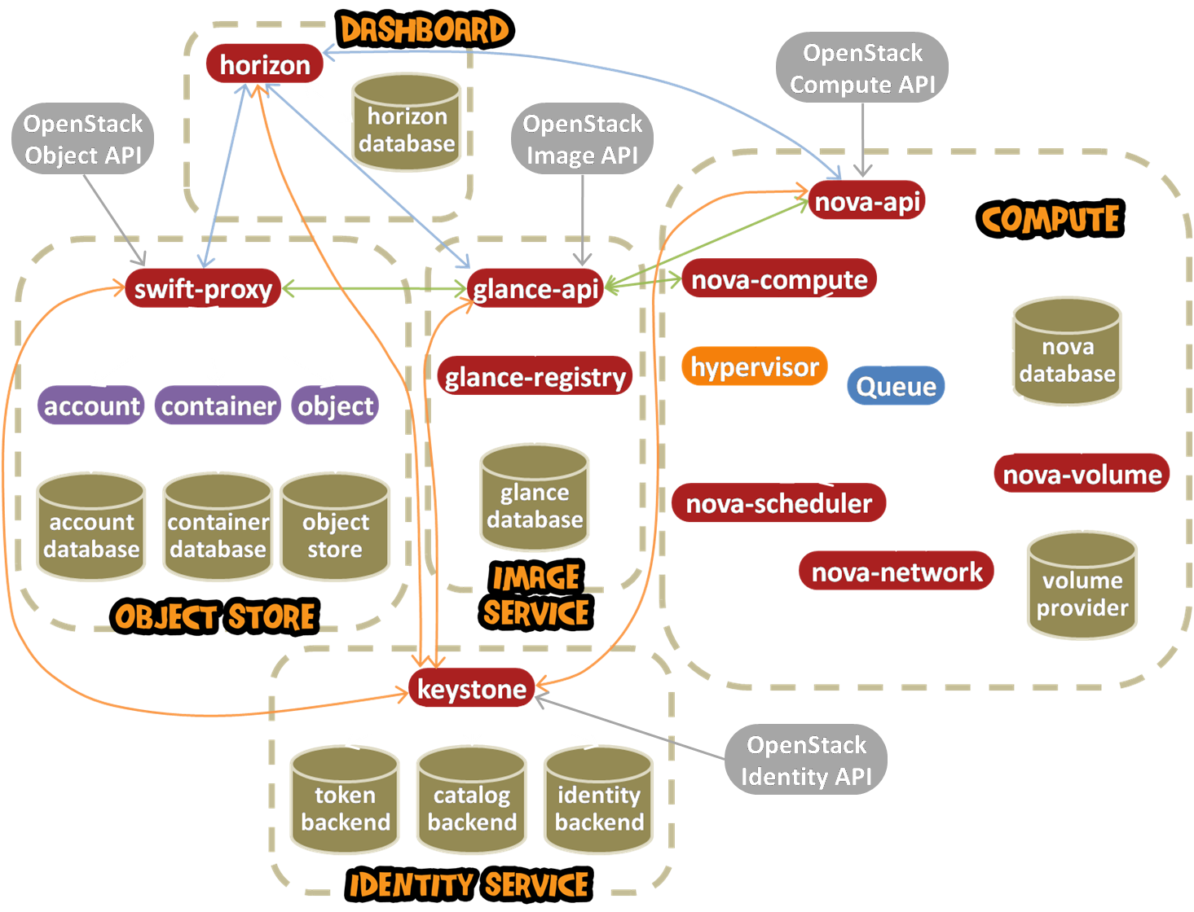
OpenStack
Architecture
Notes:
Now, this is the overall openstack architecture. You may notice that there are five groups of software component here. And, each component interact with one another by calling API. We will discuss how each compoent work later on.

Slide 35
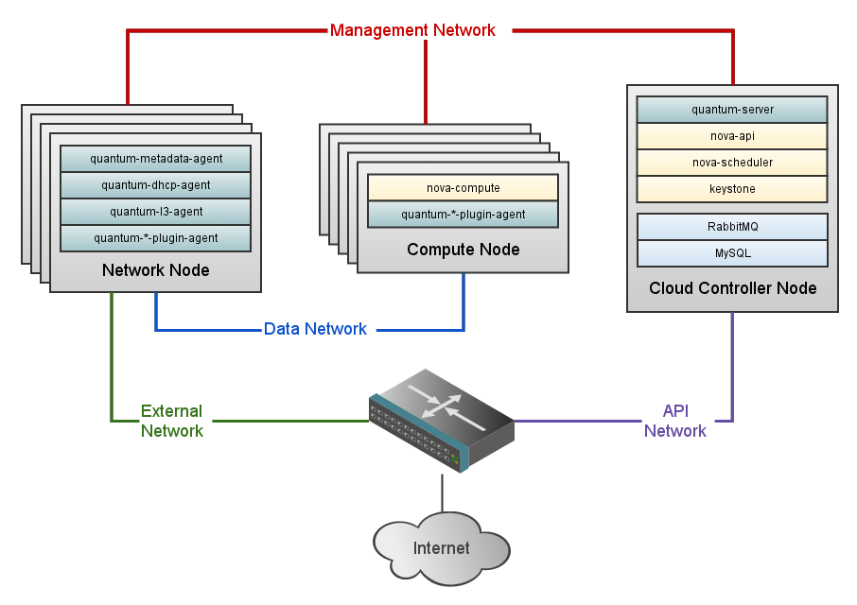
OpenStack Arhitecture
interface with users and make management decisions
run VM and store files
Send/receive packets with outside world

Slide 36
Hardware Recommendations Recommended hardware configurations for a minimum production deployment for the cloud controller nodes
Server | Recommended Hardware | Notes
Cloud Controller node (runs network, volume, API, scheduler and image services) | Processor: 64-bit x86 Memory: 12 GB RAM Disk space: 30 GB (SATA or SAS or SSD) Volume storage: two disks with 2 TB (SATA) for volumes attached to the compute nodes Network: one 1 GB Network Interface Card (NIC) | 32-bit processors will work for the cloud controller node. A quad core server with 12 GB RAM would be more than sufficient for a cloud controller node. Two NICS are recommended but not required.
http://docs.openstack.org/

Slide 37
Hardware Recommendations Recommended hardware configurations for a minimum production deployment for the compute nodes
Server | Recommended Hardware | Notes
Compute nodes (runs virtual instances) | Processor: 64-bit x86 Memory: 32 GB RAM Disk space: 30 GB (SATA) Network: two 1 GB NICs | Note that you cannot run 64-bit VM instances on a 32-bit compute node. A 64-bit compute node can run either 32- or 64-bit VMs, however. With 2 GB RAM you can run one m1.small instance on a node or three m1.tiny instances without memory swapping, so 2 GB RAM would be a minimum for a test-environment compute node.
http://docs.openstack.org/

Slide 38
ScienceCloud System Architecture
Data Network
Compute Node:
nova-compute
Quantum-plugin
Cloud Controller:
nova-compute
nova-network
nova-scheduler
nova-api
Keystone
Dashboard
glance
Quantum-agents
Quantum-plugin
Mangmt Network
Compute Node:
nova-compute
Quantum-plugin
Compute Node:
nova-compute
Quantum-plugin
Compute Node:
nova-compute
Quantum-plugin
External
Network
Notes:
This slide show the architecture of OpenStack deployment on our testbed. Here, we use three machines to run various openstack components. The first machine is the “Cloud controller” machine. It acts as a leader of every host in the testbed. It also run software component that:
-Perform authentication,
Decide where to run VM instance,
Work as network gateway,
Receive commands from users, etc.
The next component is the compute node where Openstack run VM on. The cloud controller can also run the VM in our setting.
Finally, the last host is the glance server where we store collection of images. In this configuration, we only use it to store image and do not run VM here. Note that memcache is being used to speed up image retrieval.

Slide 39
OpenStack Releases
Nova
Swift
Glance
Keystone
Horizon
Quantum
Cinder
Nova
Swift
Glance
Folsom
Sep 27, 2012
Diablo
Sep 22, 2011
Nova
Swift
Glance
Grizzly
Apr 4, 2013
Bexar
Feb 3, 2011
Nova
Swift
Glance
Keystone
Horizon
Quantum
Cinder
Essex
Apr 5, 2012
Nova
Swift
Glance
Keystone
Horizon
Cactus
Apr 15, 2011
Nova
Swift
Glance
Austin
Oct 21, 2010
Nova
Swift

Slide 40
User/Tenant/Role
User is a login name to OpenStack
Tenant or Project represents user capability and resource quota
Role represent user’s authority over the system

Slide 41
OpenStack Network Model
Fixed IP is an internal IP address inOpenStack
Floating IP is Public IP address for external accesses
Use Cases:

Slide 42
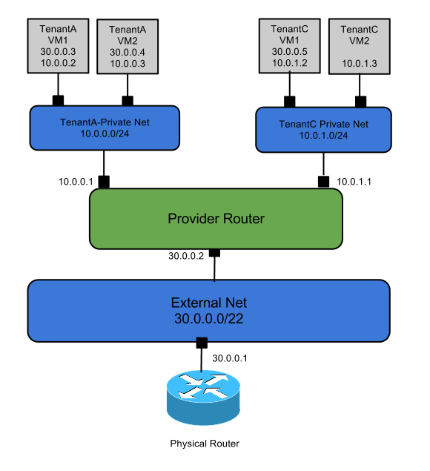
Use Case: Provider Router with Private Networks

Slide 43
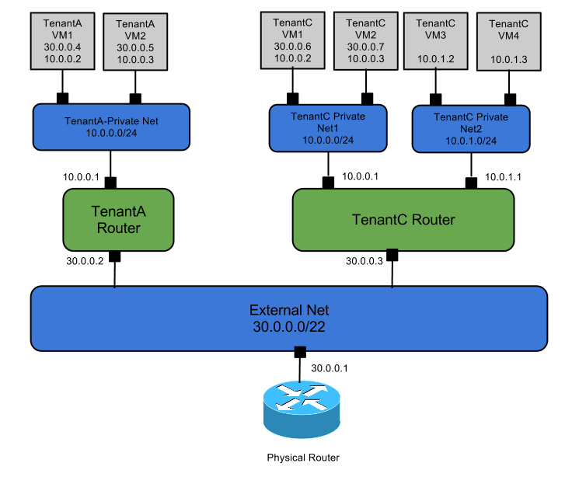
Use Case: Per-tenant Routers with Private Networks

Slide 44
DEMO

Slide 45
Overview
2
Dashboard overview
Create Instance
เข้าใช้งาน instance ทางหน้า console
ใช้ Remote Desktop เพื่อ transfer file
Terminate Instance
Crate a Cluster Computer

Slide 46
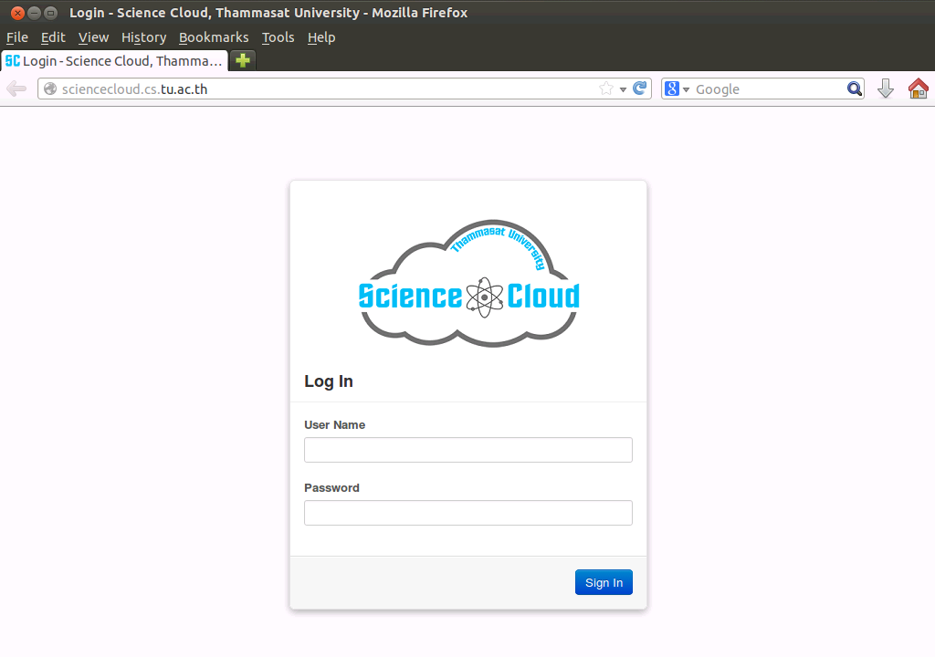
Dashboard overview
3
Log In
http://sciencecloud.cs.tu.ac.th

Slide 47
Dashboard overview
4
❸
❷
❶

Slide 48
Dashboard overview
5
Access & Security
OUT
IN
MY INSTANCE
Default Security

Slide 49
Dashboard overview
6
MY COMPUTER
Access & Security
RDP
OUT
IN
RDP
MY INSTANCE
Allow RDP

Slide 50
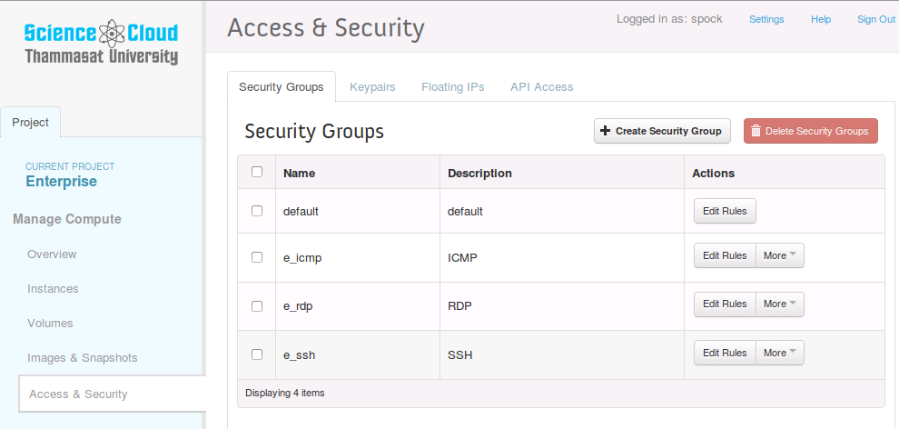
Dashboard overview
7
Access & Security
ICMP
RDP
SSH

Slide 51
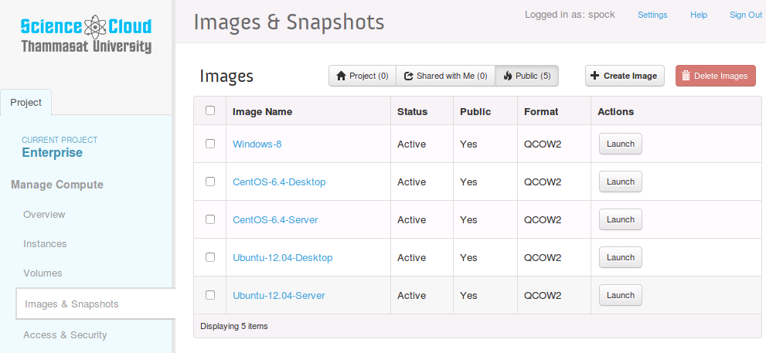
Dashboard overview
8
Images & Snapshot

Slide 52
Dashboard overview
9
Instances
คลิ๊กที่ Instances จะยังไม่มีรายการขึ้นมา เพราะเรายังไม่ได้สร้าง Instance

Slide 53
Create Instance
10
เลือก Windows
เลือก medium
หรือ large

Slide 54
Create Instance
11
เลือก RDP

Slide 55
Create Instance
12
เลือก Enterprise

Slide 56
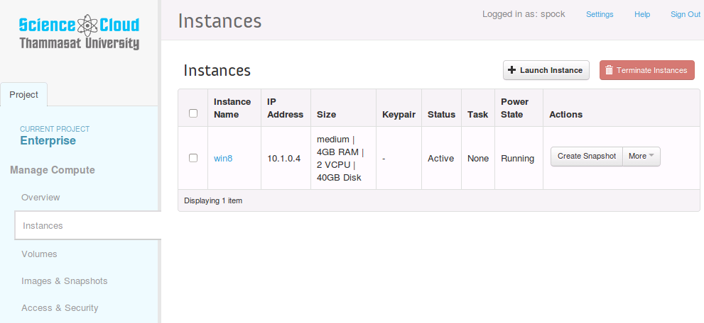
Create Instance
13
คลิ๊ก Launch แล้วรอให้ Status Active

Slide 57
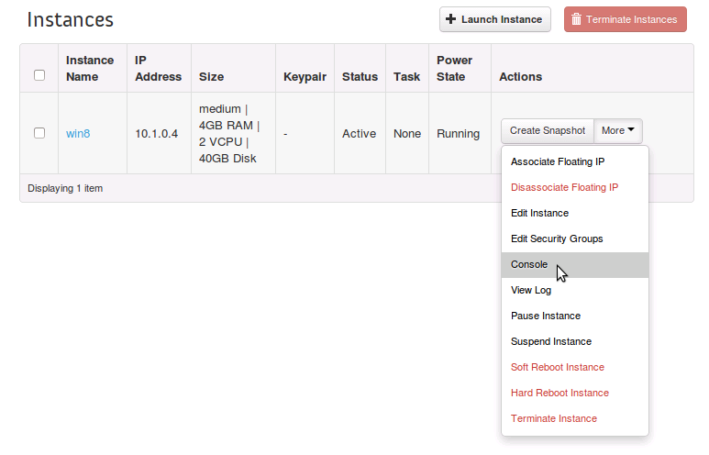
เข้าใช้งาน instance ทางหน้า console
14
More -> Console

Slide 58
เข้าใช้งาน instance ทางหน้า console
15
ตรวจสอบว่าสามารถใช้ internet ได้
ตรวจสอบจำนวน RAM, CPU

Slide 59
ใช้ Remote Desktop เพื่อ transfer file
16
Associate Floating IP

Slide 60
ใช้ Remote Desktop เพื่อ transfer file
17
Associate Floating IP

Slide 61
ใช้ Remote Desktop เพื่อ transfer file
18
Associate Floating IP

Slide 62
ใช้ Remote Desktop เพื่อ transfer file
19
Enable Remote Desktop บน instance

Slide 63
ใช้ Remote Desktop เพื่อ transfer file
20
เปิด Remote Desktop Connection บนเครื่อง local

Slide 64
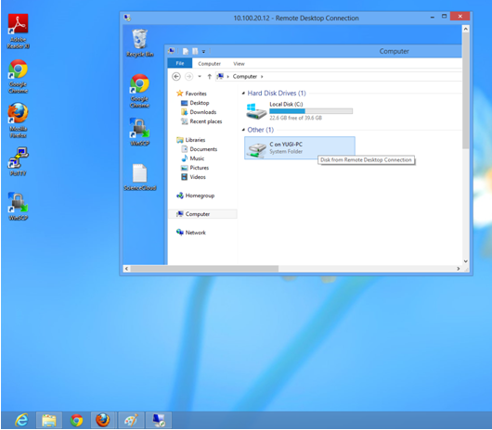
ใช้ Remote Desktop เพื่อ transfer file
21
เปิด Remote Desktop Connection บนเครื่อง local

Slide 65
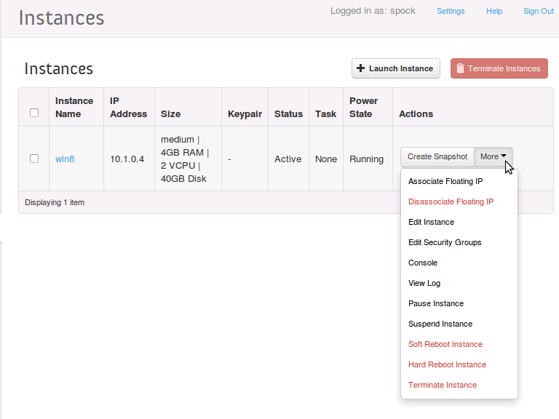
Terminate Instance
22

Slide 66
Creating a Cluster Computer on OpenStack

Slide 67
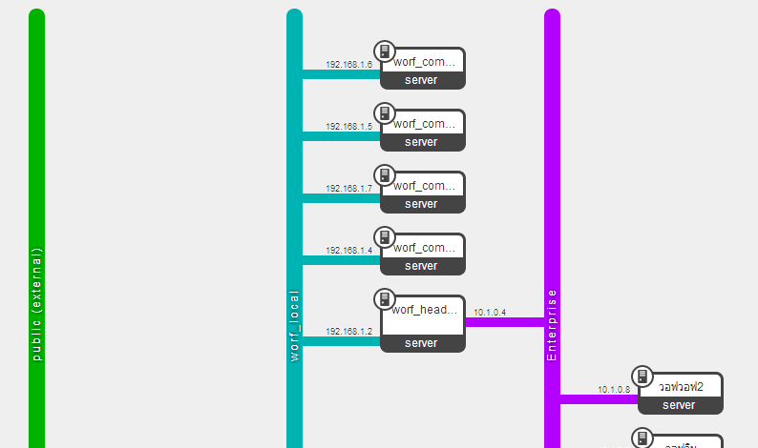

Slide 68
Create a local network

Slide 69
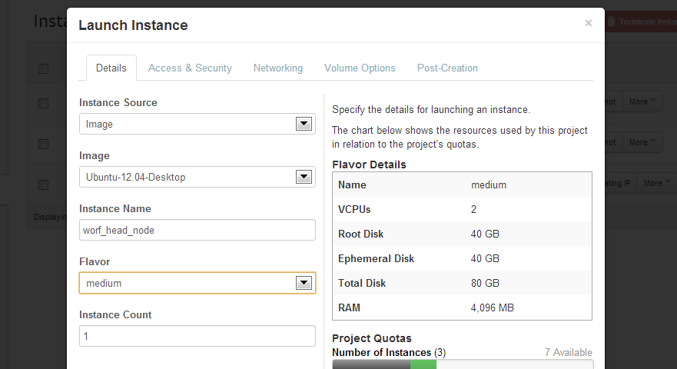
Launch a head node

Slide 70
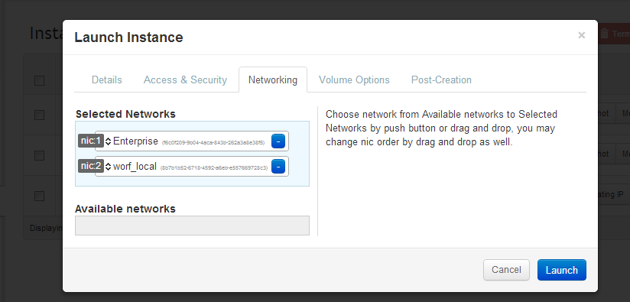

Slide 71
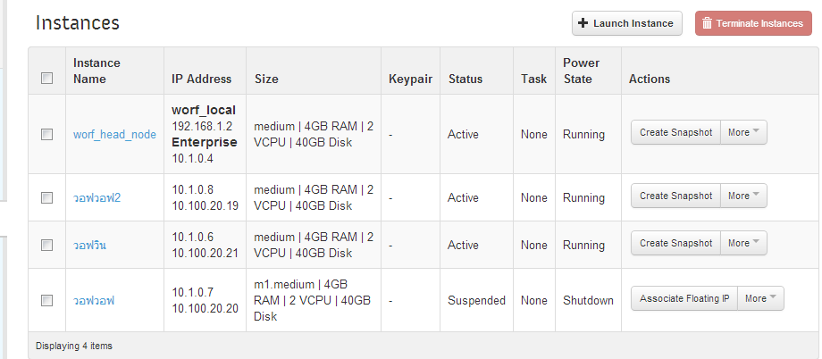

Slide 72
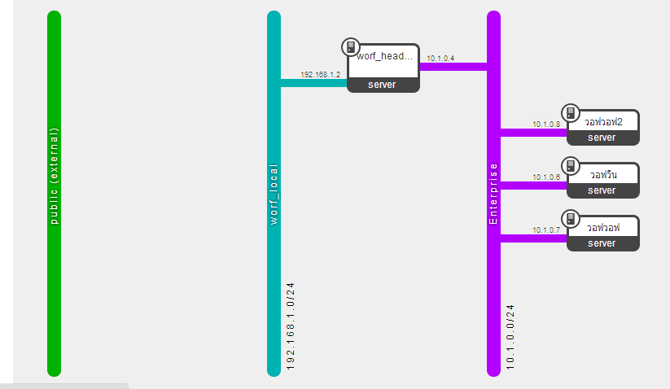

Slide 73
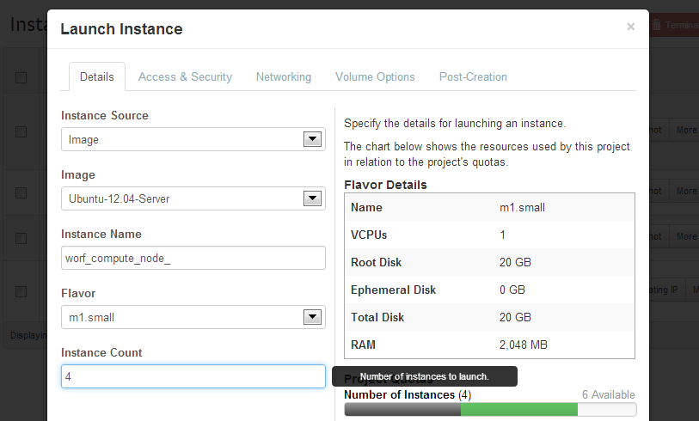
Launch compute nodes

Slide 74
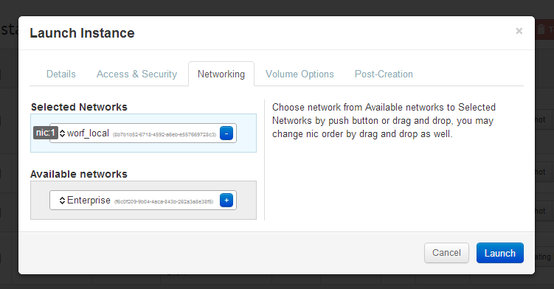

Slide 75
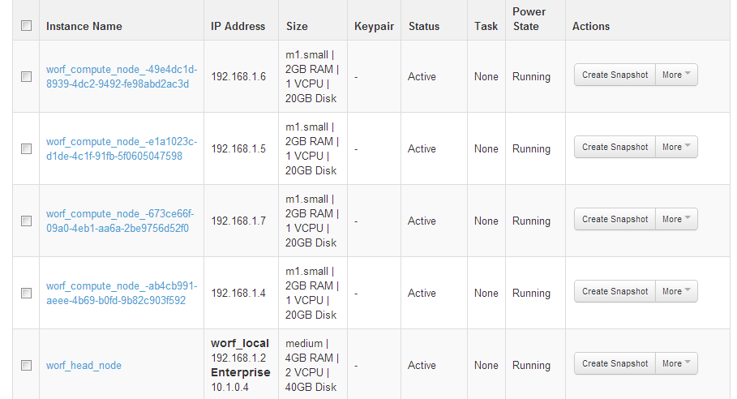

Slide 77
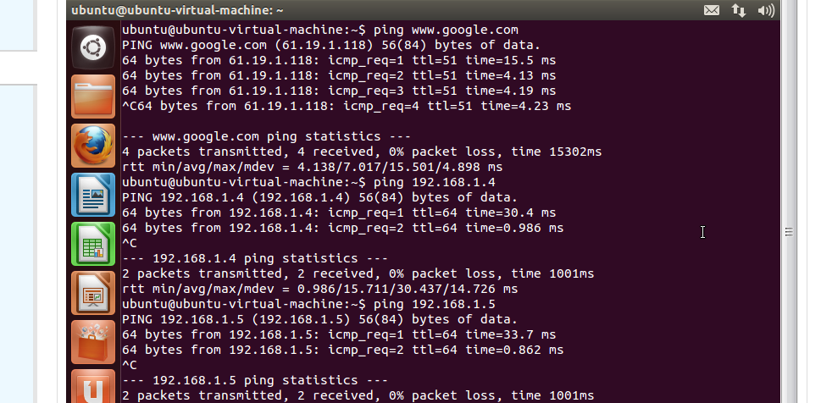

Slide 78
BACKUP

Slide 79
สถาปัตยกรรม OpenStack
DASHBOARD
KEYSTONE

Slide 80
สถาปัตยกรรม OpenStack
NOVA-COMPUTE
NOVA-API
NOVA-SCHED

Slide 81
สถาปัตยกรรม OpenStack
QUANTUM SERVER
QUANTUM-PLUGIN
QUANTUM-AGENTS
QUANTUM-PLUGIN

