Slide 2
Bringing BIG DATA to your Business Analytics
Wattanapong Wongtrakool
Principal Sales Consultant
Oracle Thailand
Notes:
Need to fix and add picture to the right

Slide 3
Oracle Safe Harbor
The following is intended to outline our general product direction. It is intended for information purposes only, and may not be incorporated into any contract. It is not a commitment to deliver any material, code, or functionality, and should not be relied upon in making purchasing decisions. The development, release, and timing of any features or functionality described for Oracle’s products remains at the sole discretion of Oracle.

Slide 4
Agenda
TOP 10 strategies CIO Issues 2013
Problems that Big Data Solves
Oracle Data Integration for Big Data
Oracle Data Integration for Business Analytics
Summary

Slide 5
Big Data Buzz
“Are you ready for the era of big data?”
“Big data: science’s microscope of the 21st century”
“The promise of big data”
Intelligent Utility - 8/28/11
McKinsey Quarterly - 11/11
Business Week – 11/8/11
“Big data, analytics get even bigger, hotter in 2012”
“Decisions, decisions…will big data have big impact?”
“Health care is next frontier for big data”
InfoWorld – 12/30/11
Wall Street Journal – 1/19/12
Financial Times – 1/24/12
Notes:
“Big data” is a buzz term with a lot of momentum right now. Everyday there is a new headline about the promise of big data and how it can change the way you do business. But what does it really mean?

Slide 6
The Top 10 Strategic CIO Issues For 2013
1 | Simply IT and Transform Your Spending: Kick the 80/20 Budget Habit
2 | Lead the Social Revolution : Drive the Social-Enabled Enterprise
3 | Unleash Your company’s Intelligence :Create the Enterprise-Wide Opportunity Chain
4 | Embrace the Engagement economy : Merge the Back office and the Front Office into the Customer Office.
5 | Future-Proof Your IT Architecture
6 | Upgrade “Cloud Strategy” to “Business Transformation enabled by the Cloud”
7 | Transform Big Data into Big Insights, Big Vision and Big Opportunities
8 | Preside over a Shotgun Wedding : Systems of Record Marry Systems of Engagement.
9 | Lead with Speed :CIO as Chief Acceleration Officer
10 | Bend the Value Curve : More Innovation, Less Integration
Source : www.forbes.com
Notes:
7) Transform Big Data into Big Insights, Big Vision, and Big Opportunities. In the past year or so, much of the talk about Big Data has obscured the fact that the real issue is enabling intelligent and instantaneous analysis to provide optimal insights for business decisions. CIOs need to ensure they’re looking at these high-volume, high-velocity challenges in the right way: as business enablers, not tech projects. For example: What if you could enable dynamic pricing of your company’s products around the globe? What if you could perform fraud-detection analytics across all of your transactions in real time, instead of across just a random sampling of only a few percent of all those transactions? What if you could analyze three years’ worth of customer data in minutes, rather than only the past three months in hours? In the meantime, we can be certain that the scale and speed of this current challenge will only increase as CIOs must rapidly and seamlessly enhance their traditional corporate data with vast new streams of social and mobile data to realize the full potential of these strategic Big Opportunities.

Slide 7
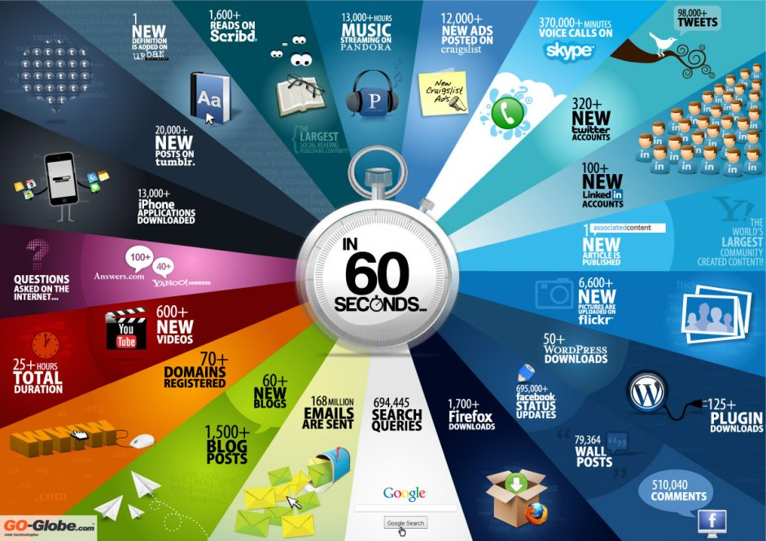
Notes:
Here’s something interesting I thought I would share with you. You can’t talk about big data without talking about the internet. These statistics around what can be accomplished in 60 seconds amaze me, and I’m sure you as well. Almost 700,000 status updates on Facebook? And half of those 168 million emails are completely junk mail. Look at the amount of data, volumes,
But how can we make this data relevant to our business? What do we do with all this data? Well, we can analyze it for patterns? Understand customers sentiment? Build better advertising? Optimize our business operations. And companies are doing just that now.
While not all ‘internet data’ = big data, I still thought it’s a good warmup for today’s discussion! So before another 60 seconds pass again, let’s continue!

Slide 8
Defining Big Data
GEODATA
TEXT
SENSOR
DATA
VOLUME
VELOCITY
VARIETY
VALUE
Notes:
If we look at this conundrum put another way. Today’s IT is challenged with the how it can take on big data which subscribes to the 3 Vs (what you may have read about if you’ve been studying big data lately: Variety (complexity), Volume, Velocity
I’d like to add a 4th V which is “Value”. That value takes on several forms of deeper analytics, improved agility, massive scale and real-time. Getting to that value can be elusive. Companies need to rethink their architectures to address these new requirements. We’re going to look at some of these key principles in a moment…
But before we do, I’d like to remind our viewers about Oracle’s offerings in Big Data.

Slide 9
Divided Solution Spectrum
Data Variety
Unstructured
Distributed File Systems
MapReduce Solutions
NoSQL Flexible Specialized Developer Centric
Schema-less
Transaction (Key-Value) Stores
DBMS (OLTP)
DBMS (DW)
Advanced Analytics
ETL
SQL Trusted Secure Administered
Schema
Acquire
Organize
Analyze

Slide 10
Hadoop to Oracle – Bridging the Gap
Data Variety
Unstructured
HDFS
Hadoop MapReduce
Schema-less
No SQL
Oracle Loader for Hadoop
RDBMS (OLTP)
RDBMS (DW)
ETL
Advanced Analytics
Schema
Acquire
Organize
Analyze

Slide 11
Oracle Integrated Software Solution
Data Variety
Unstructured
HDFS
Hadoop
Oracle Analytics:
Data Mining R Spatial Graph mapreduce
Oracle (DW)
Schema-less
Oracle NoSQL DB
Oracle Loader for Hadoop
Oracle Data Integrator
Oracle (OLTP)
Schema
OBI EE
Acquire
Organize
Analyze

Slide 12
Real World Use Cases for Big Data
Industry | New Data | What’s Possible | Why?
Healthcare Improve Quality and Efficiency | Practitioner’s notes; machine statistics | Best practices, reduced hospitalization | Increase industry value by $300 B per year
Retail One size fits all marketing | Weblog, click streams | Micro-segmentation, recommendations | Increase net margin by 60%
Banking Fraud detection; risk analysis | Weblogs, transaction systems, fraud reports | Semantic discovery; pattern detection | Billions of Dollars lost in bank fraud annually
Location-Based Services Based on home zip code | Personal location data | Geo-advertising, traffic, local search, more. | Increase revenue for providers by $100B+
Utilities Resilient and adaptable grid | Smart meter reading, call center data | Real-time and predictive utilization analysis | Energy use expected to grow by 22 percent by 2030
Notes:
Big Data offers huge challenges and ultimately opportunities in multiple industries, whether it’s healthcare, Manufacturing, Government, Retail and many others. Let’s take one example and look at it in a little more detail with Retail
According to Mckinsey, they see 60% Potential increase in retailers operating margins based on implementation of customer ‘sentiment analysis’ based on better leveraging their data. The combination of social media data + weblogs + existing structured data in their data warehouse and CRM systems can give them a more complete view of the not only what their customers purchased, but what they ‘are about to purchase’.

Slide 13
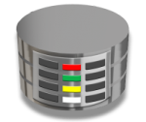
Tapping into Diverse Data Sets
Information Architectures Today:
Decisions based on transactional data
transactions, applications, structured Data
Video and Images
Information Architectures Today:
Decisions based on all your data
Documents
Social Data
Machine-Generated Data
Notes:
But how do you get at this exceptional value? …
This is one of the first challenges around Big Data… Information architectures bases many of today’s ‘business decision making’ on transactional data. This is data about your customers in CRM systems, or about number of orders that passed within your service bus, or amount of records in your database. But what about this data?
Video, documents, social data, machine generated information from sensors, the sky is the limit here. Consequently there seems to be not limit to the amount this data is growing in the industry. Can we actually get the useful information collected from exabytes, petabytes of data?

Slide 14
Oracle Integrated Solution Stack for Big Data
Hadoop (MapReduce)
HDFS
Oracle Big Data Connectors
Data
Warehouse
Analytic Applications
Oracle NoSQL Database
In-Database Analytics
Oracle Database
Oracle Data Integrator
ACQUIRE
ORGANIZE
ANALYZE
DECIDE
Notes:
In the context of the different challenges of Big Data, we classify it into these 4 important categories. Acquire, Organize, Analyze, and finally Decide. For each solution area of the industry challenge, Oracle has a best-in-class solution. One that can be componentized to address a single aspect of the problem, or built together as a whole. In addition, these solutions leverages optimized hardware and software which is especially critical to address the need of those 3 Vs that we talked about.
For the remainder of this webcast, we’re going to focus on Organize component which features ‘integration’ as it’s core element. Those products we’re going to be unveiling in a little more detail are Oracle Data Integrator and Big Data Connectors. But before that, let’s first hear from Helen Sun who will walk us through the Architecture Principles and Best Practices around Big Data.

Slide 15
Oracle Data Integration for Big Data

Slide 16
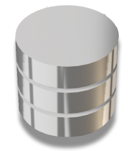
Oracle Data Integrator
Bulk Data Processing and Big Data Transformation
CEP, Data Services
Oracle Data Integrator
Any Data Warehouse
Optimized E-LT Architecture
Declarative design for Lower TCO
Extensible Knowledge Modules for enriching functionality (i.e. big data transformation)
Any Planning System
Notes:
ODI is at the heart of our integration strategy, and has the necessary capabilities for integrating both structured, and now semi-structured, unstructured data. A little bit about ODI in general first:
Optimized E-LT Architecture, which allows for us to run transformations flexibly on the source or target, without the need for running transformation in an intermediary server. This improves performance and efficiency which is critical for supporting the volumes of loads in Big Data
Easy to use interface for Declarative design for Lower TCO, this can be applied to generating mapReduce Code which we’ll dive into in a minute.
Extensible Knowledge Modules for enriching functionality (i.e. big data transformation). These knowledge modules allow the ODI product to be extended, just like you can extend your mobile phone with new ‘apps’ ODI has the same pluggable logic to allow for customizing logic in loading, transformation, data services, and more.

Slide 17
ODI for Big Data
Heterogeneous Integration to Hadoop Environments
Transforms
Via MapReduce
Supports Hadoop standards
Easy to configure UI for generating MapReduce
Oracle Data Integrator
Loads
Notes:
Oracle Data Integrator (ODI) Application Adapter for Hadoop provides native Hadoop integration within ODI. Specific ODI Knowledge Modules optimized for Hive and Oracle Loader for Hadoop are included within ODI Application Adapter for Hadoop. The knowledge modules can be used to build Hadoop metadata within ODI, load data into Hadoop, transform data within Hadoop, and load data easily and directly into any Hadoop environment
Hadoop implementations, whether it’s HDFS or NoSQL require complex Java MapReduce code to be written and executed on the Hadoop cluster. Using ODI and the ODI Application Adapter for Hadoop developers use a graphical user interface to create these programs. Utilizing the ODI Application Adapter for Hadoop, ODI generates optimized HiveQL which in turn generates native MapReduce programs that are executed on the Hadoop cluster.

Slide 18
ODI for Big Data to Oracle
Optimized Integration to Oracle Exadata
Oracle Big Data Connectors
Transforms
Via MapReduce
Oracle Data Integrator
Activates
Oracle Loader for Hadoop
Loads
Oracle Database,
Oracle Exadata
Hadoop Cluster
Notes:
The capability of Oracle Data Integrator for Hadoop is bundled with Big Data Connectors along with Oracle Loader for Hadoop and other tools for interfacing and accessing Hadoop environments, these can be heterogeneous environments as long as they support Hadoop standards.
In this case, ODI loads the data directly into Oracle Database utilizing the Oracle Loader for Hadoop support within the Application Adapter for Hadoop.
What makes the loading optimized: Oracle Loader for Hadoop sorts, partitions, and converts data into Oracle Database formats in Hadoop, then loads the converted data into the database. By preprocessing the data to be loaded as a Hadoop job on a Hadoop cluster, Oracle Loader for Hadoop dramatically reduces the CPU and IO utilization on the database commonly seen when ingesting data from Hadoop. An added benefit of presorting data is faster index creation on the data once in the database.

Slide 19
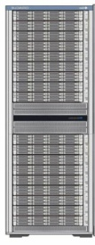
ODI for Oracle Big Data Appliance
Seamlessly Correlate Analysis for All Data in the Enterprise
Oracle Big Data Connectors
Transforms
Via MapReduce
Oracle Data Integrator
Activates
Oracle Loader for Hadoop
Loads
Oracle Database, Oracle Exadata
Oracle Big Data Appliance
Notes:
Oracle allows for these same solutions to run natively on an Hadoop cluster running on Oracle Big Data Appliance
Built using industry-standard hardware from Sun and Cloudera’s Distribution including Apache Hadoop, the Big Data Appliance is designed and optimized for big data workloads. By integrating the key components of a big data platform into a single product, Oracle Big Data Appliance delivers an affordable, scalable and fully supported big data infrastructure without the risks of a custom built solution. The Big Data Appliance integrates tightly with Oracle Exadata and Oracle Database using Oracle Big Data Connectors, and seamlessly enables analysis of all data in the enterprise – structured and unstructured.
Oracle Big Data Appliance makes it easy for these organizations to acquire and organize new types of data, while Oracle Big Data Connectors enables an integrated data set for analyzing by providing:
Oracle Loader for Hadoop
Oracle Direct Connector for Hadoop Distributed File System (HDFS)
Oracle Data Integrator Application Adapter for Hadoop
Oracle R Connector for Hadoop
Oracle Big Data Connectors bundles all of these capabilities in a single, optimized and supported product from Oracle.

Slide 20
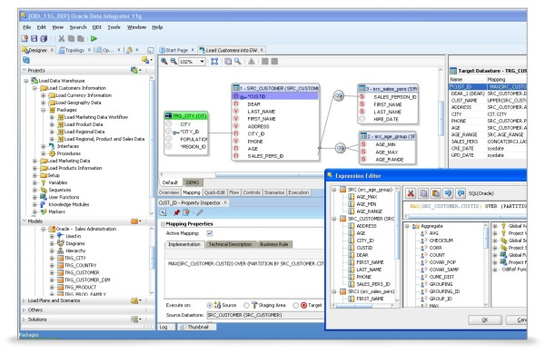
Oracle Data Integrator for Big Data
Putting Together the Unique Advantages
Simplifies creation of Hadoop and MapReduce code to boost productivity
Engineered for running on and integrating with Oracle Big Data Appliance via Big Data Connectors
Optimizes loading of big data to Oracle Exadata using Oracle Big Data Connectors
Unifies integration tooling across unstructured/semi-structured and structured data
Integrates big data heterogeneously via industry standards: Hadoop, MapReduce, Hive, NoSQL, HDFS
Notes:
Takeaway – ODI is part of Oracle’s complete data integration strategy, but specifically for Big Data, ODI is the key element you want to start with.
The unique advantages of the offering include:
Simplifies creation of Hadoop and MapReduce code to boost productivity
Integrates big data heterogeneously via industry standards: Hadoop, MapReduce, Hive, NoSQL, HDFS
Unifies integration tooling across unstructured/semi-structured and structured data
Optimizes loading of big data to Oracle Exadata using Oracle Loader for Hadoop
Integrated and optimized for running on Oracle Big Data Appliance via Big Data Connectors

Slide 21
Connecting Big Data for Analytics
Transaction/ Application data
(Heterogeneous sources)
Real-Time
Transactions
Oracle GoldenGate
Transformations
Oracle Big Data Connectors
Transforms
Via MapReduce
Oracle Data Integrator
Activates
Oracle Loader for Hadoop
Big Data
Loads
Oracle Database,
Oracle Exadata
Hadoop Cluster
Notes:
Here is the picture that combines the two big pieces of the Analytics puzzle. You can use the same technology for both your structured, transactional data with robust real-time data integration capabilities and your Big Data which includes unstructured and semi-structured data.
Oracle Data Integrator has capabilities to support all your enterprise data and enable analytics that deliver the complete picture.

Slide 22
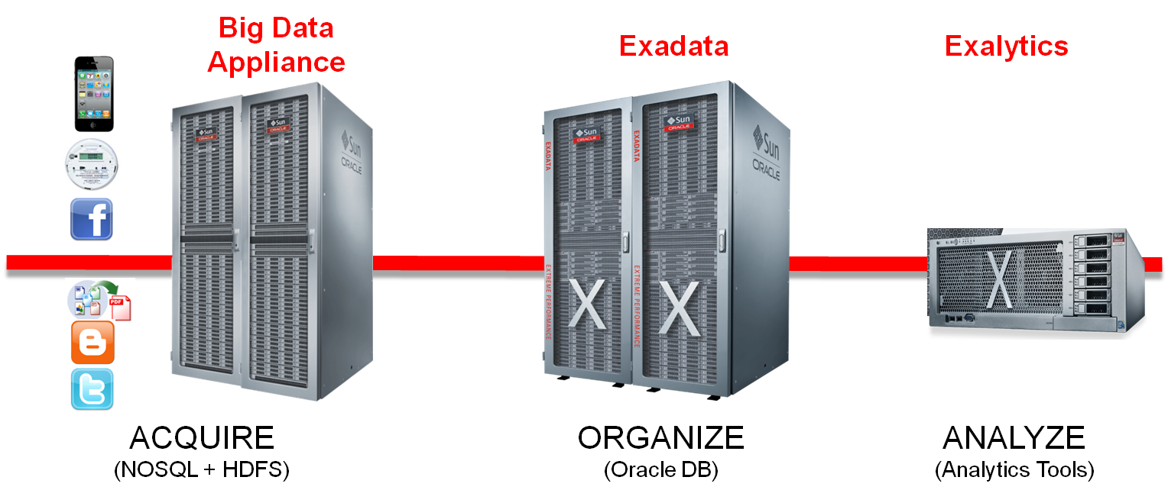
Oracle Big Data for Analytics

Slide 23
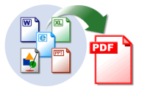
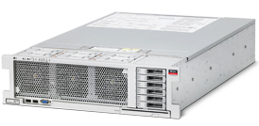
Big Data Appliance Usage Model
Oracle Big Data Appliance
Oracle Exadata
Oracle Exalytics
InfiniBand
InfiniBand
Stream
Acquire
Organize
Analyze & Visualize

Slide 24
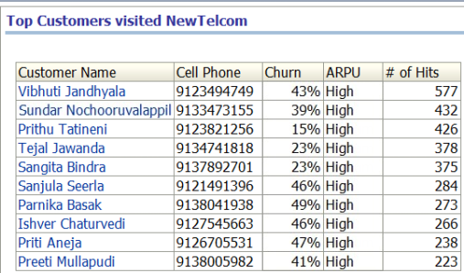
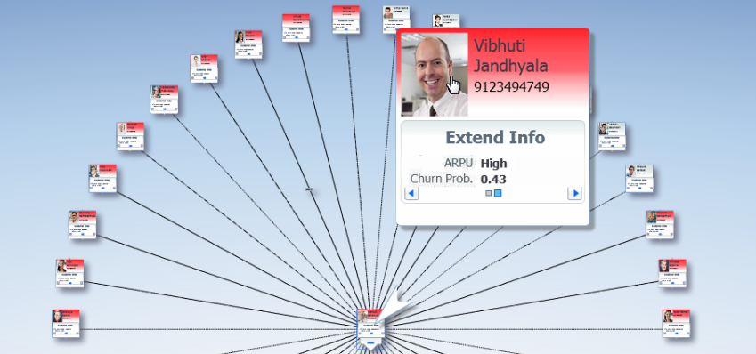
Sample Analyze
Link Analysis

Slide 25
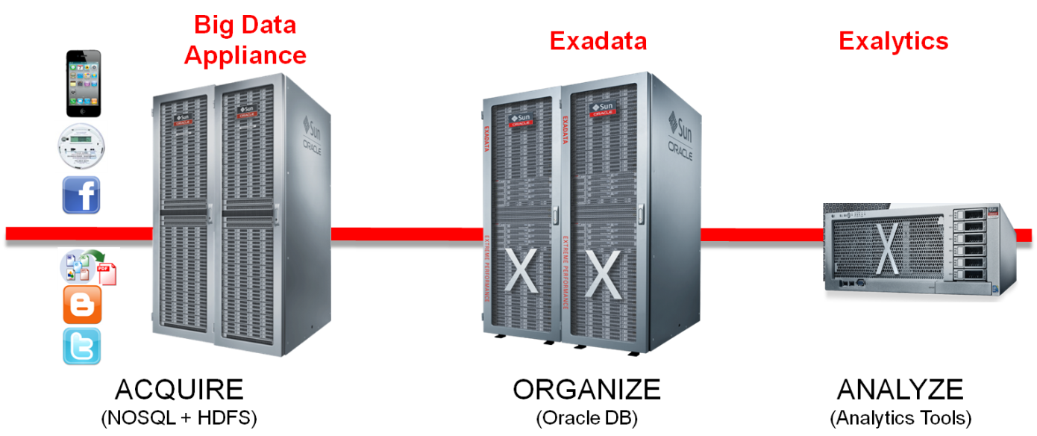
Oracle Big Data for Analytics in Data Center
HR
ERP
CRM
SCM
Billing

Slide 26
Oracle Big Data in Data Center

Slide 27
Best Practices
Adopt an Enterprise Architecture Approach
Align Big Data initiative with specific business goals
Expand Your Information Architecture
Embrace data diversity and long tail data analysis
Correlate big data and structured data
Leverage Real-Time Data for Analytics
Use center of excellence and standardize on the same technology for both Big Data and transactional data
Use non-intrusive, low-impact data capture methods
Use E-LT architecture for high performance, low TCO solution
Notes:
Here are some of the guidelines and best practices.
One key characteristics of big data is Value. Value through low-density volumes and volumes of data. As we sort through the mountains of low-value-density big data and look for the gold nugget, do not lose sight of why. Follow an enterprise architecture approach. Focus on the value it provides to the business. How does it support or enable the business objectives? Properly align and prioritize big data implementation with the business drivers is critical to get sponsorship and funding for the long run. USE A CENTER OF EXCELLENCE TO SHARE SOLUTION KNOWLEDGE, PLANNING ARTIFACTS, OVERSIGHT FOR PROJECTS. WHETHER BIG DATA IS A NEW OR EXPANDING INVESTMENT, THE SOFT AND HARD COSTS CAN BE INVESTMENT SHARED ACROSS THE ENTERPRISE. Using the same technology for both types of data will obviously help with training, speed of development and overall costs.
Some of the recent analysts surveys indicated that one of the biggest obstacles for big data is Skills shortage. A 60% shortfall is predicted by 2018. To address such risk and challenge, establish a center of excellence to grow the skill level, to select and enforce standards, and to reduce the overall risks and training cost.
Big data is here. You either embrace it or fall behind. But don’t do it because it’s exciting. Don’t treat it as a separate technological entity. Look at it in a holistic way as an extension to your overall information architecture. Establish new capabilities [AND LEVERAGE YOUR PRIOR INVESTMENTS IN INFRASTRUCTURE, PLATFORM, BI AND DW] (rather than throw away→)but don’t throw away your existing infrastructure and investment. Invest in an integration engine that can function like a human neural system, that enables your knowledge workers to correlate different types and sources of data, to make associations, and to make insightful decisions. To get to this stage, it needs to all flow seamlessly in the background for your users. They don’t have to worry about merging and integrating different sources and types of data.
Your analytics should also leverage timely information as much as possible to provide accurate conclusions. The real-time data capture can have impact on the source systems. You should choose one that is not instrusive and does not cause overhead. ELT architecture is a simple but powerful data movement architecture that delivers high performance and low TCO and should be considered for new or expanding DI projects.

Slide 28
Smart Malls Video

Slide 29
Small Mall Video #2

Slide 30
Smart Mall #3

Slide 31
Smart Mall #4

Slide 32
Smart Mall #5

Slide 33
Notes:
33
33
Thank you for your time today, I hope that this presentation was informative and useful. Please contact your Oracle data integration sales representative for more information about any of the Oracle data integration products you heard about today.

